Slide 1
Multithreaded Performance
Week 8

Slide 2
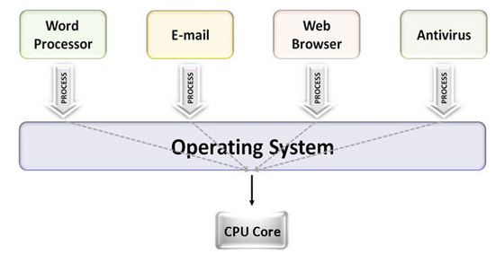
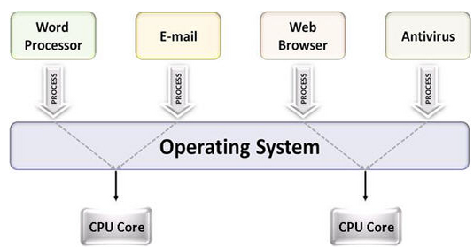
Multiprocessing
The use of multiple CPUs/cores to run multiple tasks simultaneously
Uniprocessing system
Multiprocessing system

Slide 3
Parallelism
Executing several computations simultaneously to gain performance
Different forms of parallelism
Multitasking
Several processes are scheduled alternately or possibly simultaneously on a multiprocessing system
Multithreading
Same job is broken logically into pieces (threads) which may be executed simultaneously on a multiprocessing system

Slide 4
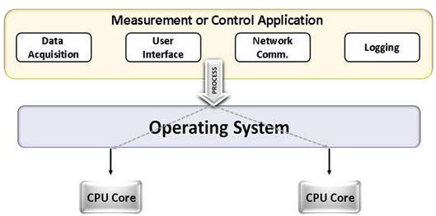
Multitasking vs. Multithreading
Multitasking
Multitasking
Multithreading

Slide 5
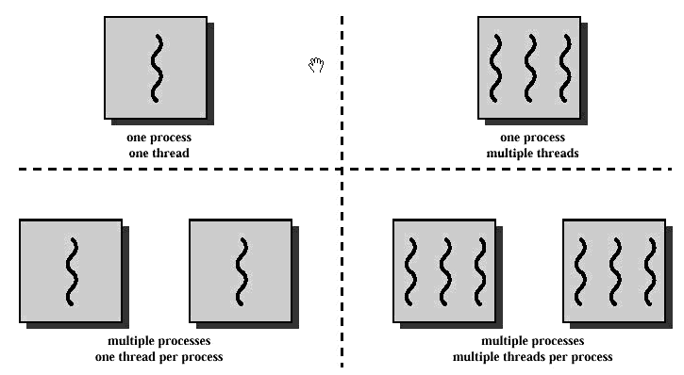
Multithreading
Multitasking

Slide 6
What is a thread?
A flow of instructions, path of execution within a process
The smallest unit of processing scheduled by OS
A process consists of at least one thread
Multiple threads can be run on:
A uniprocessor (time-sharing)
Processor switches between different threads
Parallelism is an illusion
A multiprocessor
Multiple processors or cores run the threads at the same time
True parallelism

Slide 7
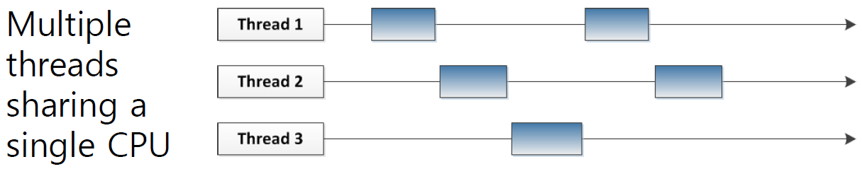
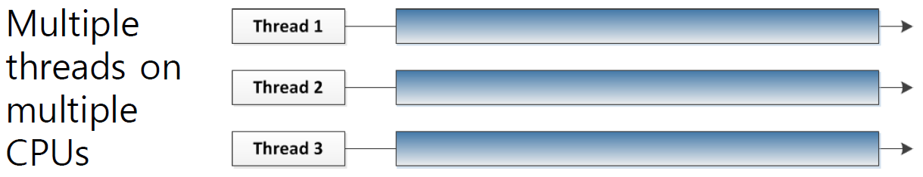

Slide 8
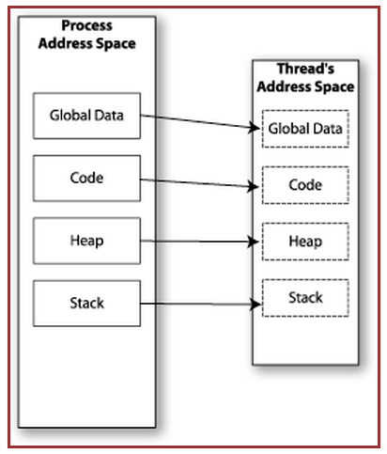

Memory Layout: Single-Threaded Program

Slide 9
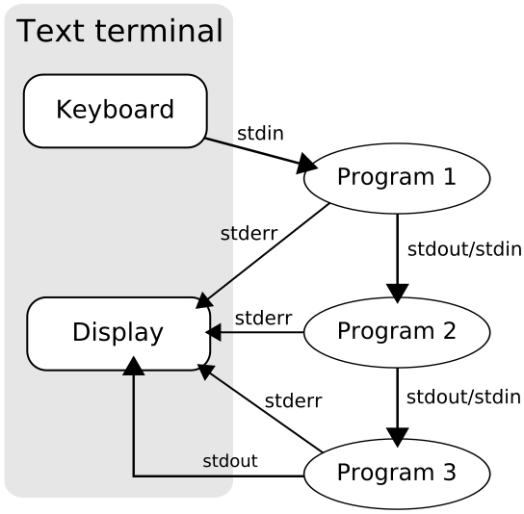
Multitasking
$ tr -cs 'A-Za-z' '[\n*]' | sort -u | comm -23 – words
Process 1 (tr)
Process 2 (sort)
Process 3 (comm)
Each process has its own
address space
How do these processes
communicate?
Pipes/System Calls
Wikipedia

Slide 10
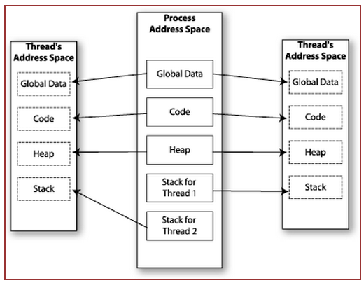

Memory Layout: Multithreaded Program

Slide 11
Multithreading
Threads share all of the process's memory except for their stacks
=> Data sharing requires no extra work (no system calls, pipes, etc.)

Slide 12
Shared Memory
Makes multithreaded programming
Powerful
can easily access data and share it among threads
More efficient
No need for system calls when sharing data
Thread creation and destruction less expensive than process creation and destruction
Non-trivial
Have to prevent several threads from accessing and changing the same shared data at the same time (synchronization)

Slide 13
Race Condition
A
B
C
int count = 0; void increment()
{ count = count + 1; }
r(count) : 0
w(count) : 1
time
r(count) : 1
r(count) : 1
w(count) : 2
w(count) : 2
Result depends on order of execution
=> Synchronization needed

Slide 14
Multithreading & Multitasking: Comparison
Multithreading
Threads share the same address space
Light-weight creation/destruction
Easy inter-thread communication
An error in one thread can bring down all threads in process
Multitasking
Processes are insulated from each other
Expensive creation/destruction
Expensive IPC
An error in one process cannot bring down another process

Slide 15
Lab 8
Evaluate the performance of multithreaded sort
Add /usr/local/cs/bin to PATH
$ export PATH=/usr/local/cs/bin:$PATH
Generate a file containing 10M random double-precision floating point numbers, one per line with no white space
/dev/urandom: pseudo-random number generator

Slide 16
Lab 8
od
write the contents of its input files to standard output in a user-specified format
Options
-t f: Double-precision floating point
-N <count>: Format no more than count bytes of input
sed, tr
Remove address, delete spaces, add newlines between each float

Slide 17
Lab 8
use time -p to time the command sort -g on the data you generated
Send output to /dev/null
Run sort with the --parallel option and the
–g option: general numeric value
Use time command to record the real, user and system time when running sort with 1, 2, 4, and 8 threads
$ time –p sort –g --parallel=[1, 2, 4, or 8] file_name > /dev/null
Record the times and steps in log.txt

